Slide 1
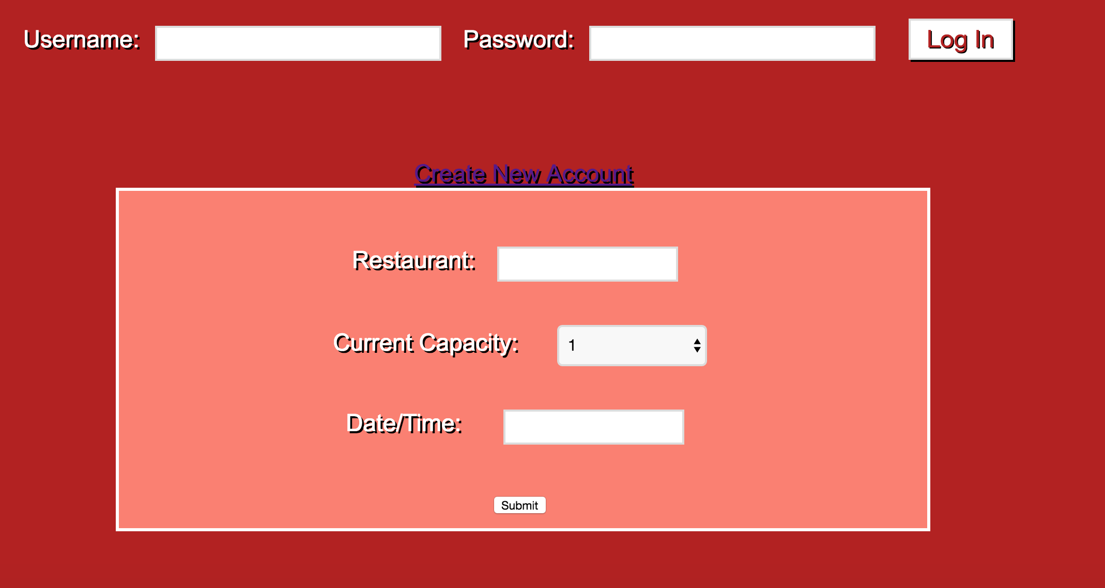
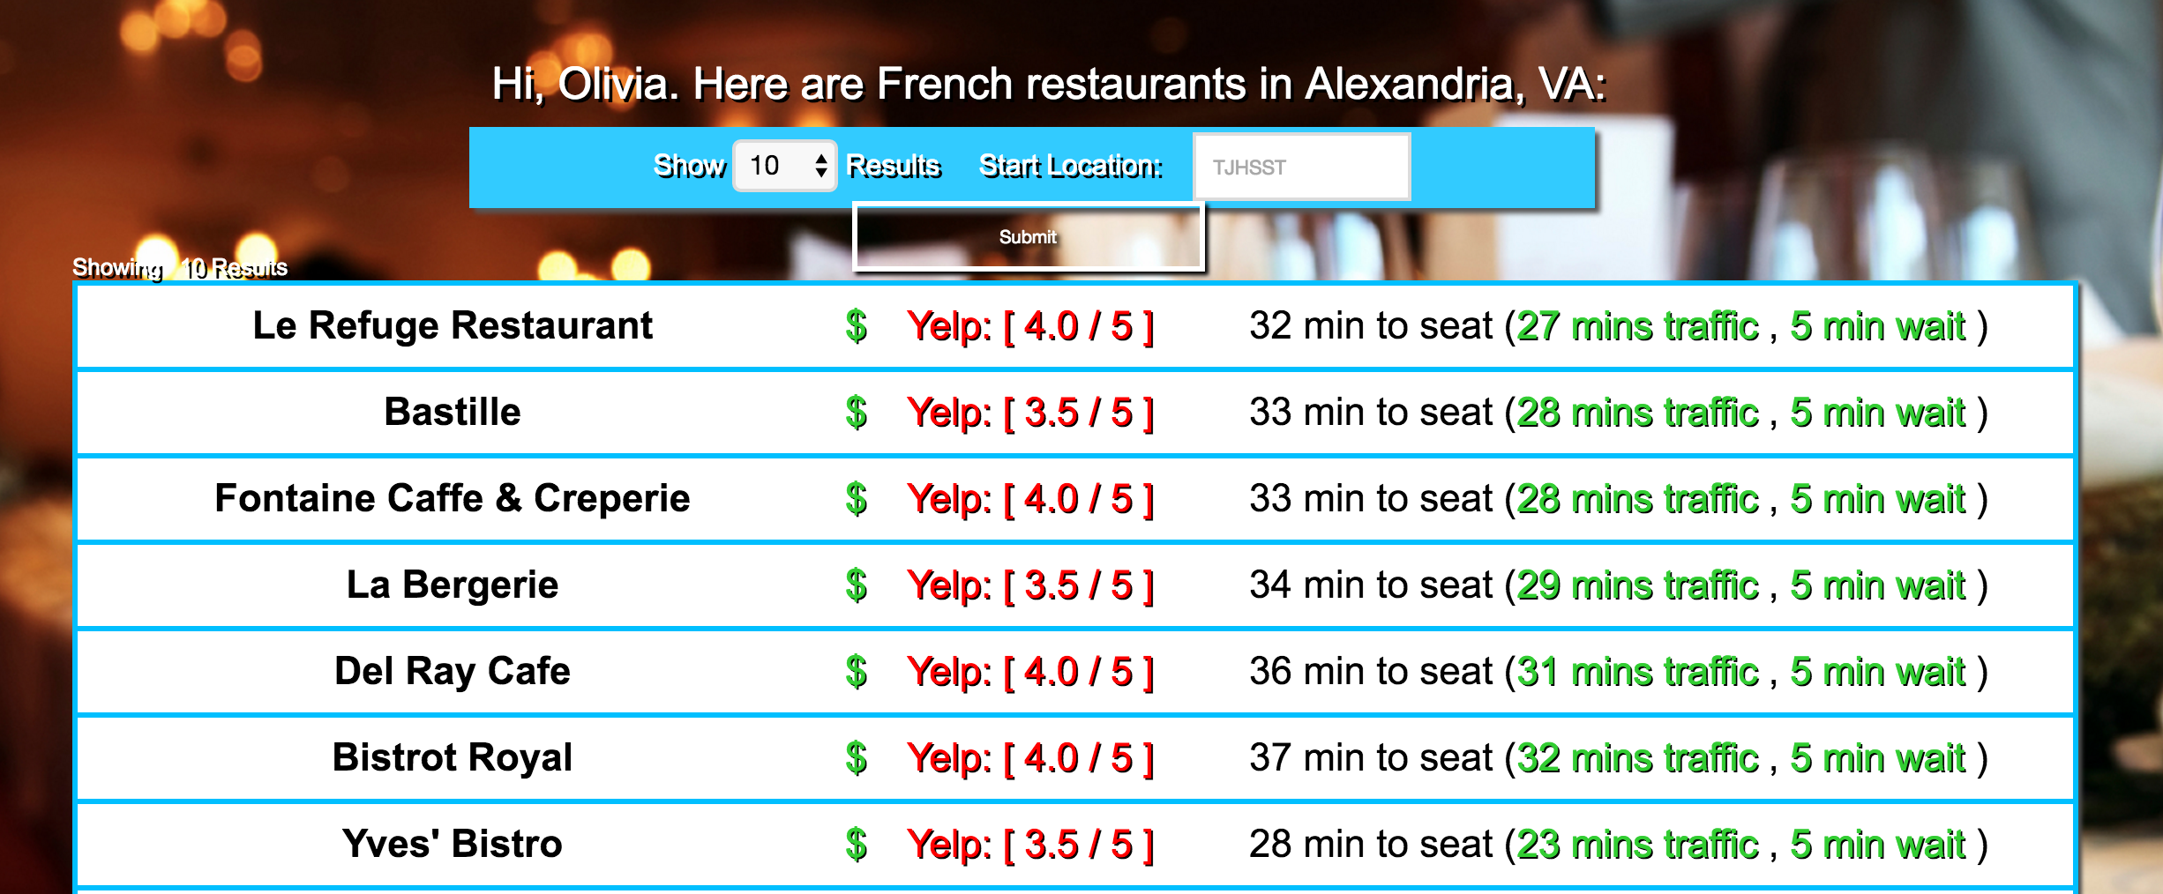
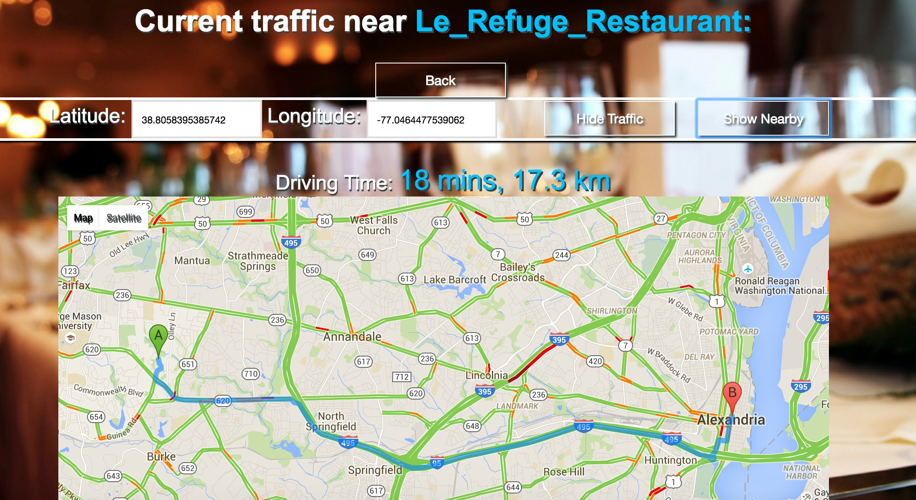
Web Application for Optimizing
Restaurant Experience
Olivia Zhang
Computer Systems Research Lab 2015-16
Dr. Gabor
Introduction
Restaurant capacity and “crowdedness” can have tremen-dous impact on the quality of a dining experience, and affect wait time as well as service speed. While several technology services exist for the restaurant industry, a ca-pacity measuring website is a relatively unexplored area.
The Restaurant Capacity Tracker site uses real time information from various Web APIs to estimate the current capacity of a restaurant. From a list of restaurants fitting the given specifications, the user may choose the best option from the calculated results to plan a convenient dining experience.
Site Functionalities (cont.)
The Login page allows users the option to access accounts and facil-itates site usage by storing the name and “home location” of the user, and auto-fills these values into each search. A user can also report real time capacity value for a restaurant they may currently be at, represented as an integer from 1 (Least Crowded) to 5 (Extremely Busy), which is then used in the calculation algorithm.
Capacity Algorithm
The capacity is displayed as a waiting time in the application. Sev-eral factors are assigned number values, and a weighted average is scaled and translated into a time duration. The primary factors in the capacity algorithm are day of the week, with weekend and Friday as the busiest, and time of day, with evenings as the busiest. Past re-views are also parsed for key phrases and wait times. In the ac-count system, users have the option to report real-time capacity in-formation to the site, which is also used in the algorithm: the current time is checked with the time reported by the user, and the reported capacity is incorporated into the calculation.
Site Functionalities
After “Cuisine Type” and “Location” fields are submitted, the site returns a list of restaurants, with the option to alter the number displayed. The price range, aver-age rating, Yelp page link and estimated driving time are displayed in columns, with each row comprising a restaurant. If the restaurant exists in the OpenTable database, a link to make a reservation is displayed.
Upon clicking on the “estimated driving time”, shown in green, the user is di-rected to the traffic page, where he or she can view the route from a given start location to the restaurant. Zooming capabilities and an option to toggle traffic dis-play are also included. The “directions” button provides a list of step-by-step driving instructions through the Google Maps directions services.
Project Structure
The site is built using JavaScript, HTML, and PHP. The site communicates with the Yelp API, Google Maps API, and Open Table API to receive the following information about restaurants: address, cuisine type, and average rating from Yelp; estimated driving time from a given start location from Google Maps; and price range and reservation information from the Open Table API.
Relevant information is stored in a SQLite database, from which an algorithm is used to calculate the estimated ca-pacity. The algorithm uses the time of day, type of restau-rant, and capacity trends parsed from user reviews to deter-mine a numerical estimate.
In addition, the site uses an account system to customize the page for the user by prefilling known fields, and receives real-time user input on capacity to aid its calculations.
Fig. 4: Screen capture of the form for real-time user-reported capacity.
Fig. 2: Screen capture of the restaurant results page.
Browser
Data Storage
Data for the Restaurant Capacity site is stored using an SQLite data-base, with tables for (1) User Account Information, (2) Restaurant Information, and (3) Reviews. For each account, the reviews con-tributed by that user are tracked by storing the keys of each review in an array field of the user.
Server
Conclusions & Future Work
The application provides a streamlined view of real-time restaurant information, and aids the user in choosing a place to eat.
Future improvements include the creation of a more sophisticated cal-culation algorithm that more comprehensively incorporates past user reviews and time of day to detect capacity trends and yields closer estimations for capacity, in addition to recognizing exceptions for holi-days, closings, etc. Load time of the results page can also be improved by caching previous searches and increasing code efficiency.
Fig. 1: The server communicates with APIs from Yelp, OpenTable, and Google Maps to display the results in the browser.
Fig. 3: Screen capture of the traffic page, with options to view driving routes.

